Slide 1
Taking action for nature at (insert school name)
Our Nature Park journey this year

Slide 2
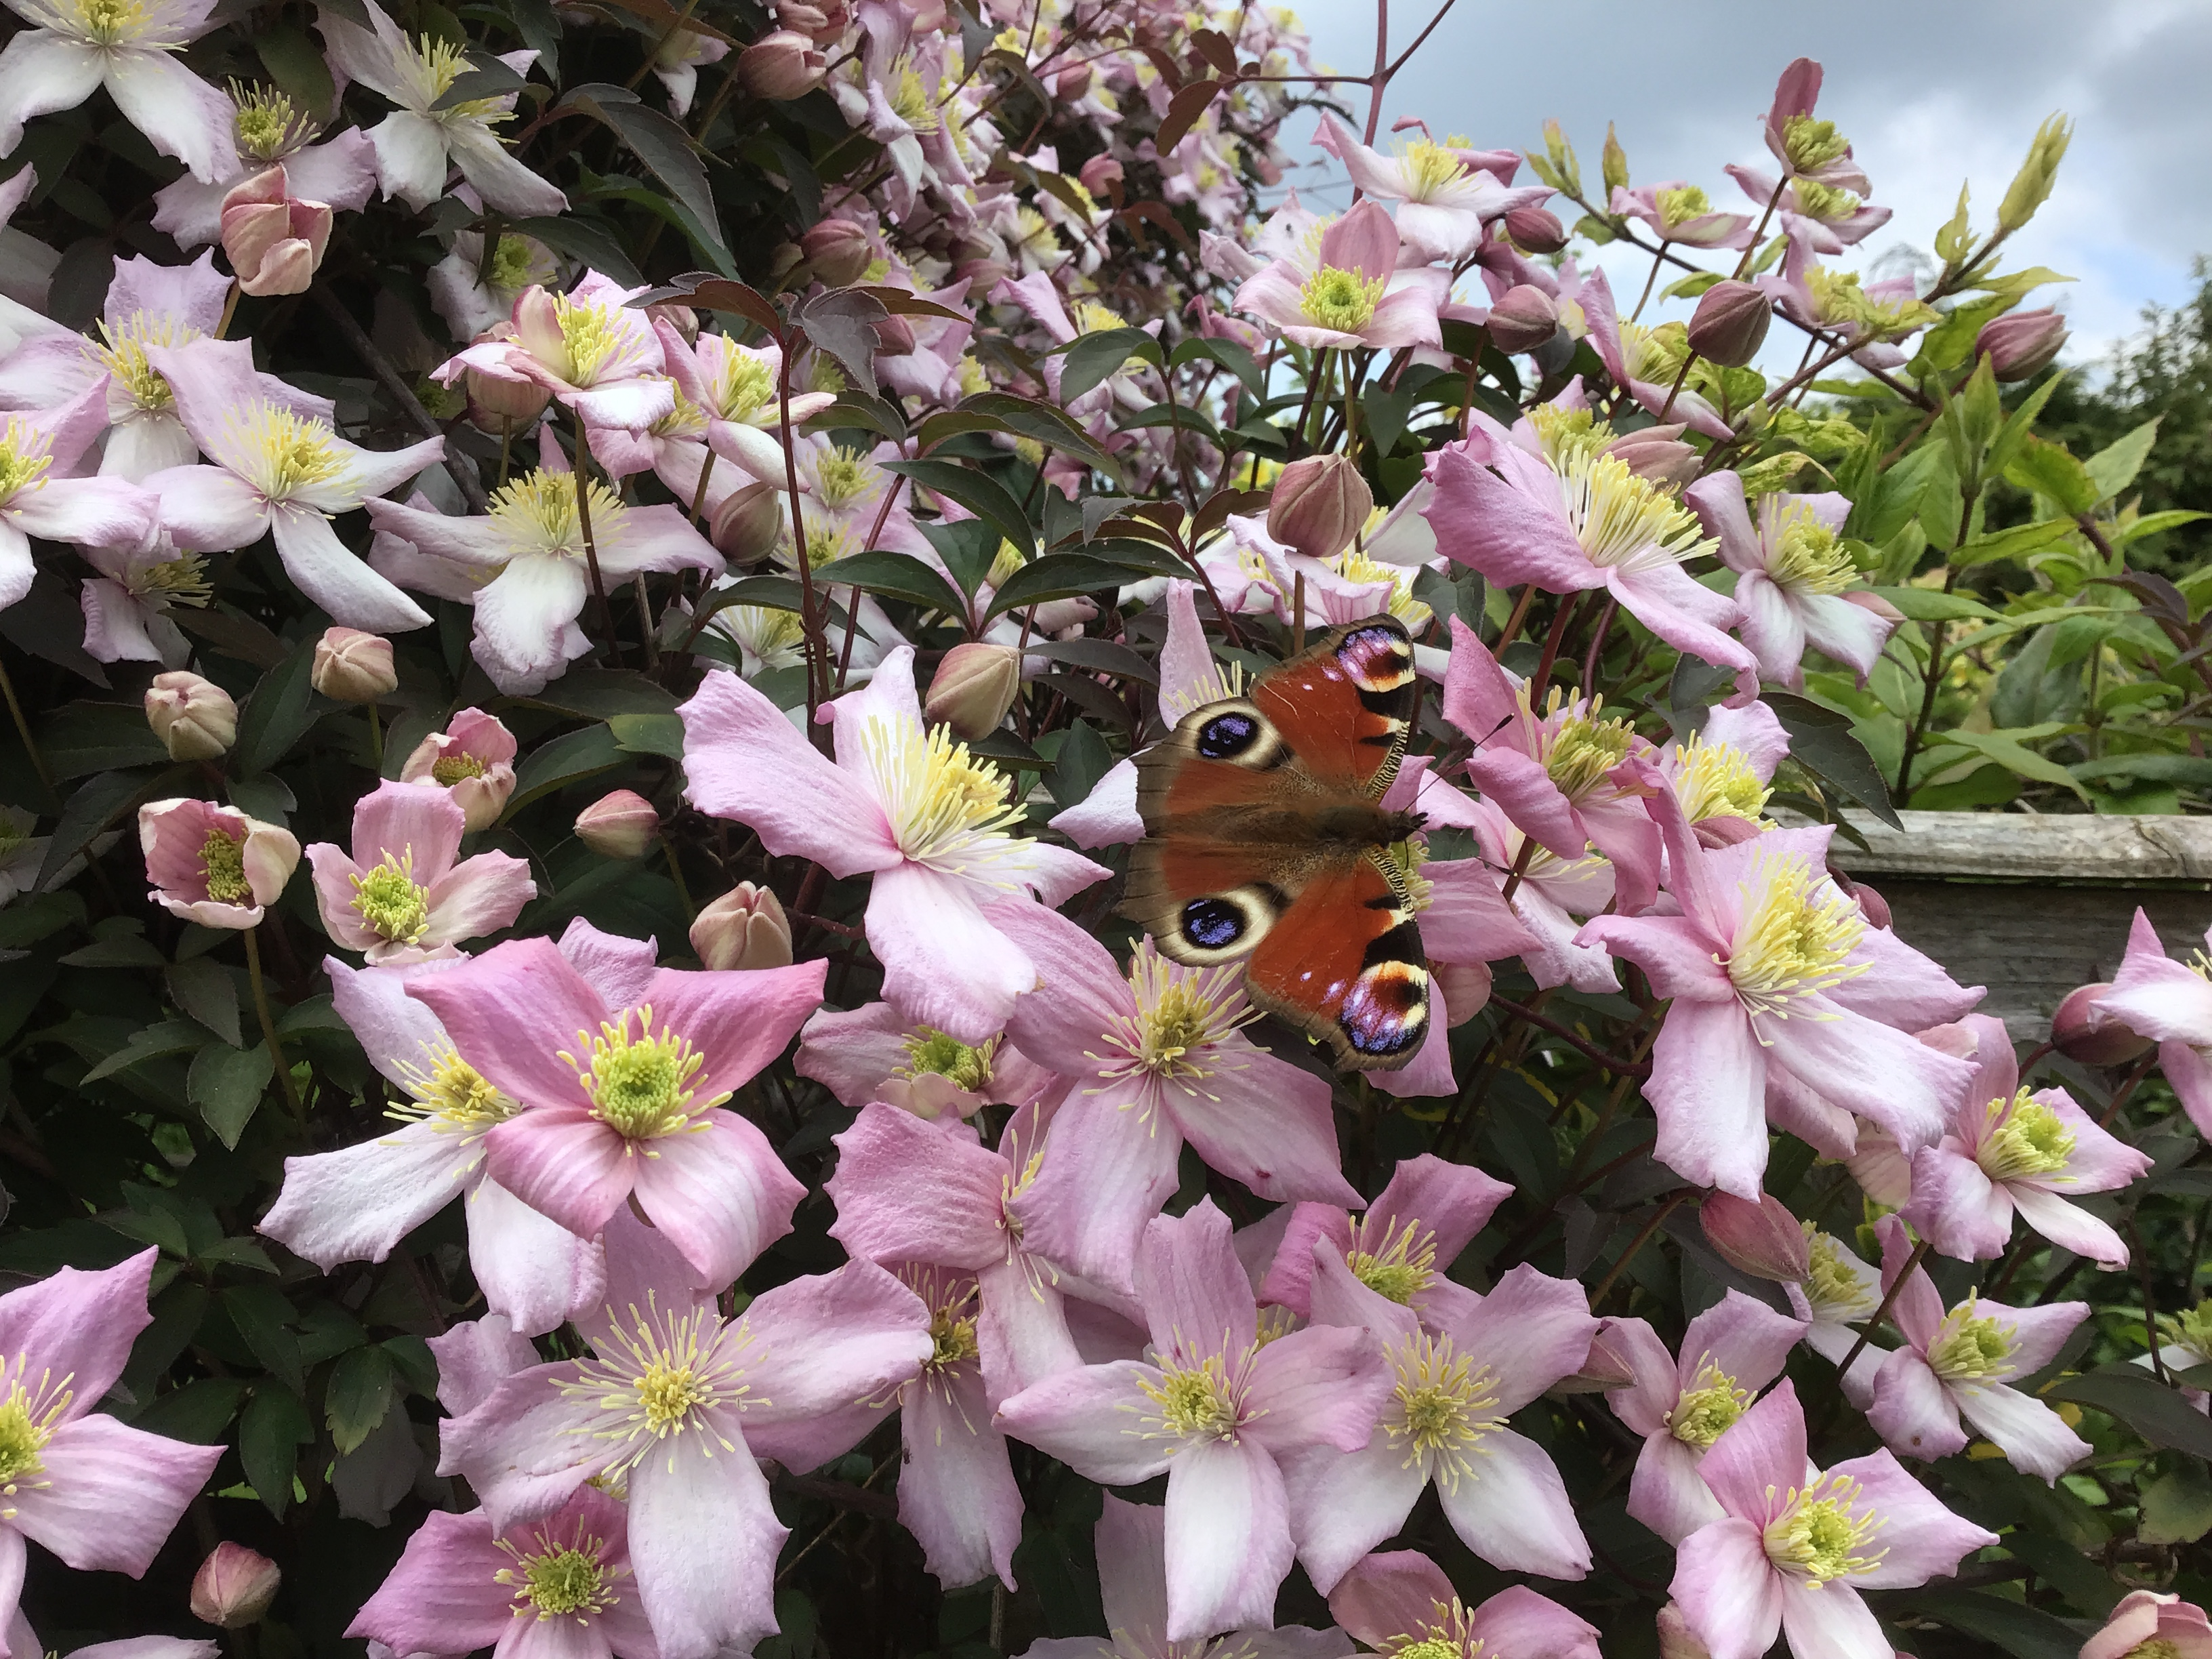
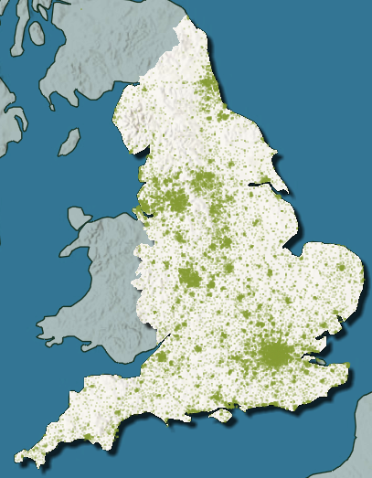
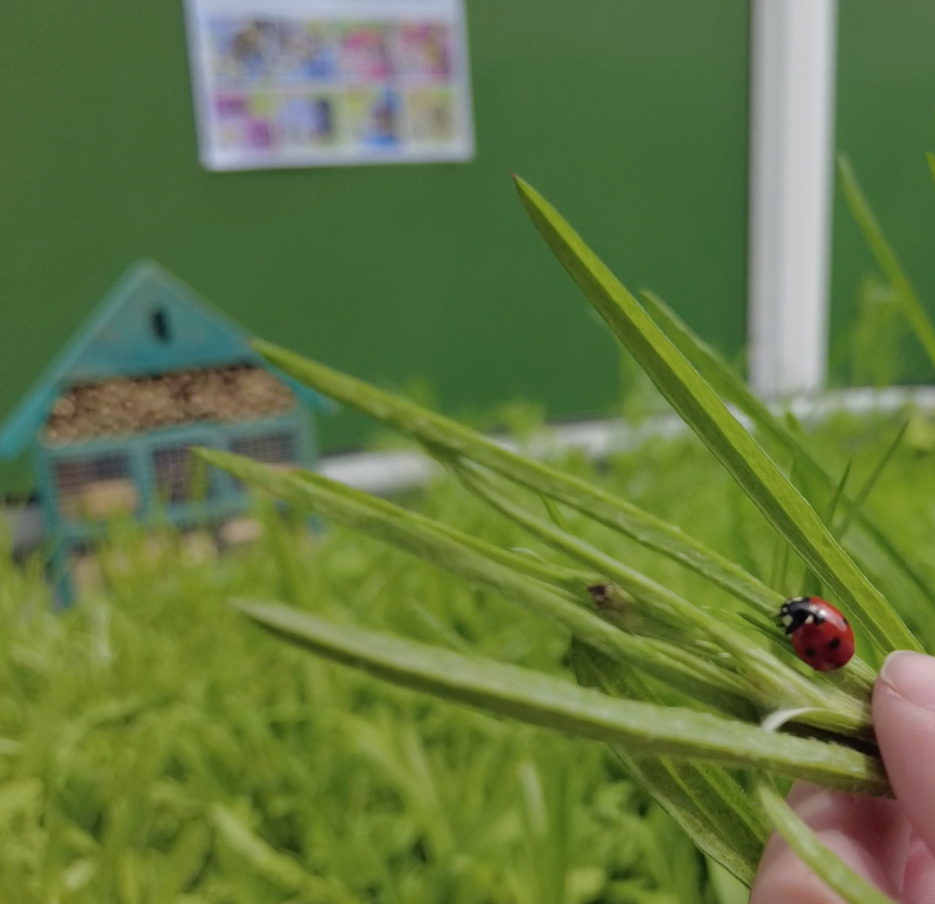
The National Education Nature Park
Notes:
We have been taking part in the National Education Nature Park, a network of education settings across England who are taking action to protect and improve their space for people, plants, animals and insects.
Our grounds are our nature park. Each school has been working to make their nature park better for people and wildlife and together all of the small changes we are making is adding up to make a positive difference for nature in England.
The images on screen are from the hidden nature challenge and the map in the middle shows all of the schools, colleges and nurseries in England.

Slide 3
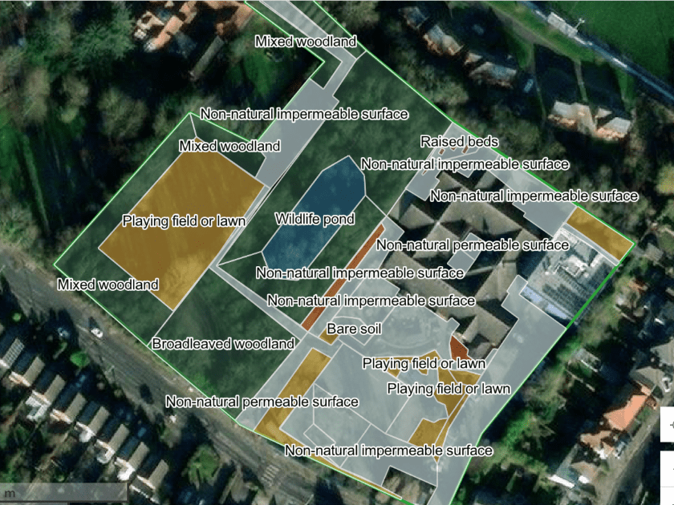
Putting (insert setting name) on the map
Notes:
Screenshot your site boundary and/or habitat map and paste it into this slide to show how your setting has joined the nationwide map.

Slide 4
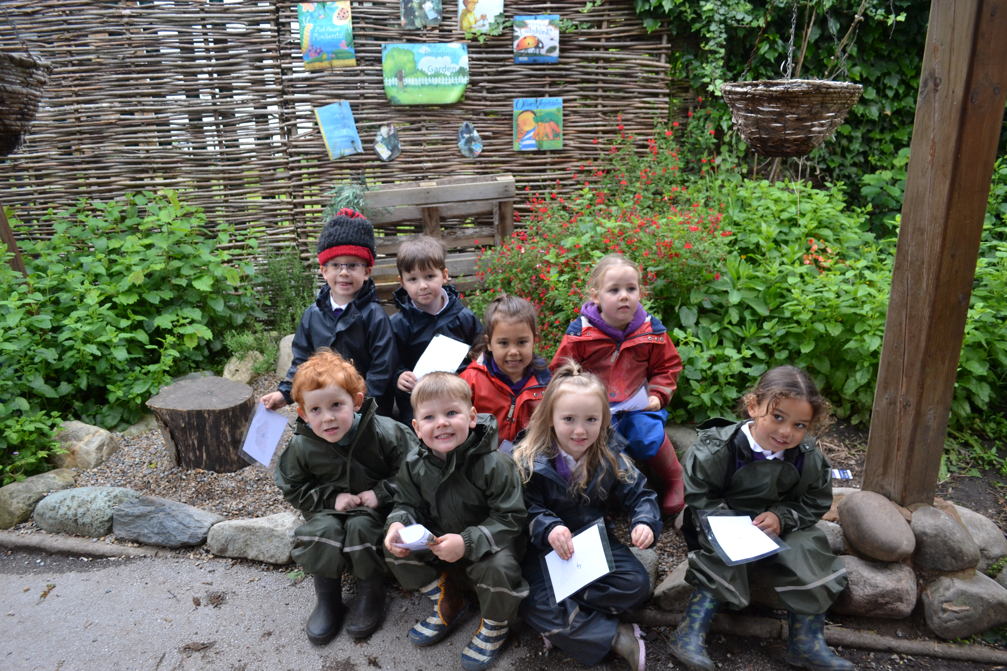
Quiz
How many schools, nurseries and colleges are part of the Nature Park so far?
Nearly 3000
1000
500

Slide 5
Quiz
How many schools, nurseries and colleges are part of the Nature Park so far?
Nearly 3000
Nearly 3000 schools are part of the Nature Park! We are an important part of the network of schools, colleges and nurseries in England taking action for nature.

Slide 6
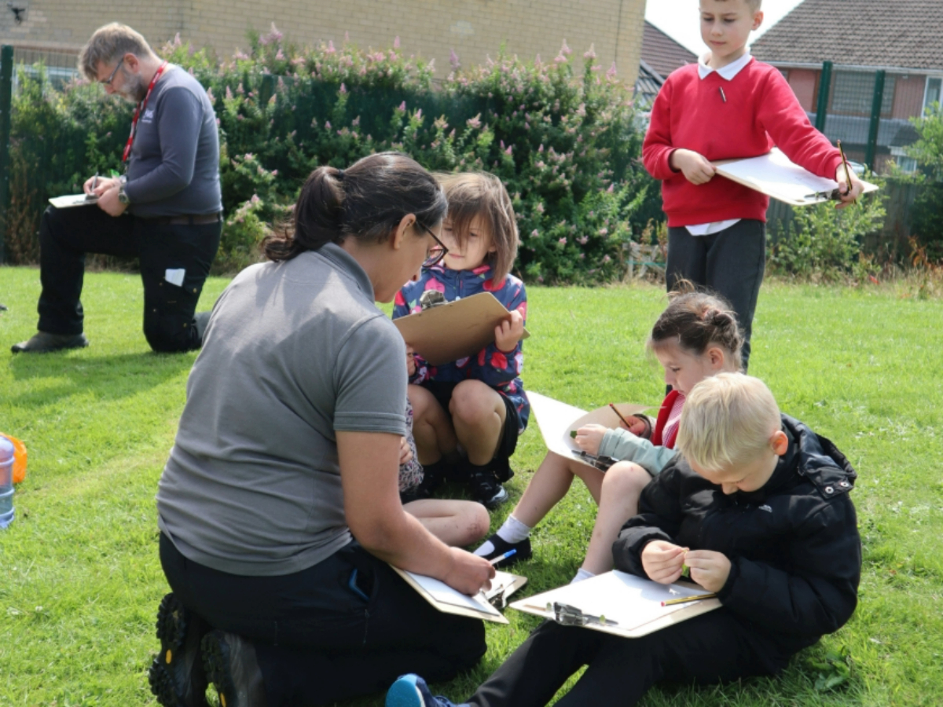
Quiz
What did Nature Park schools/colleges/nurseries do this year?
Install a pond
Discover hidden nature on their site
Imagined being a spider

Slide 7
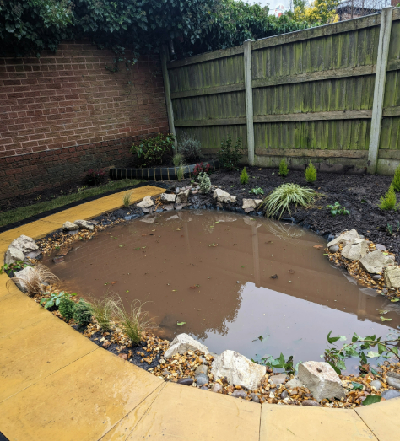
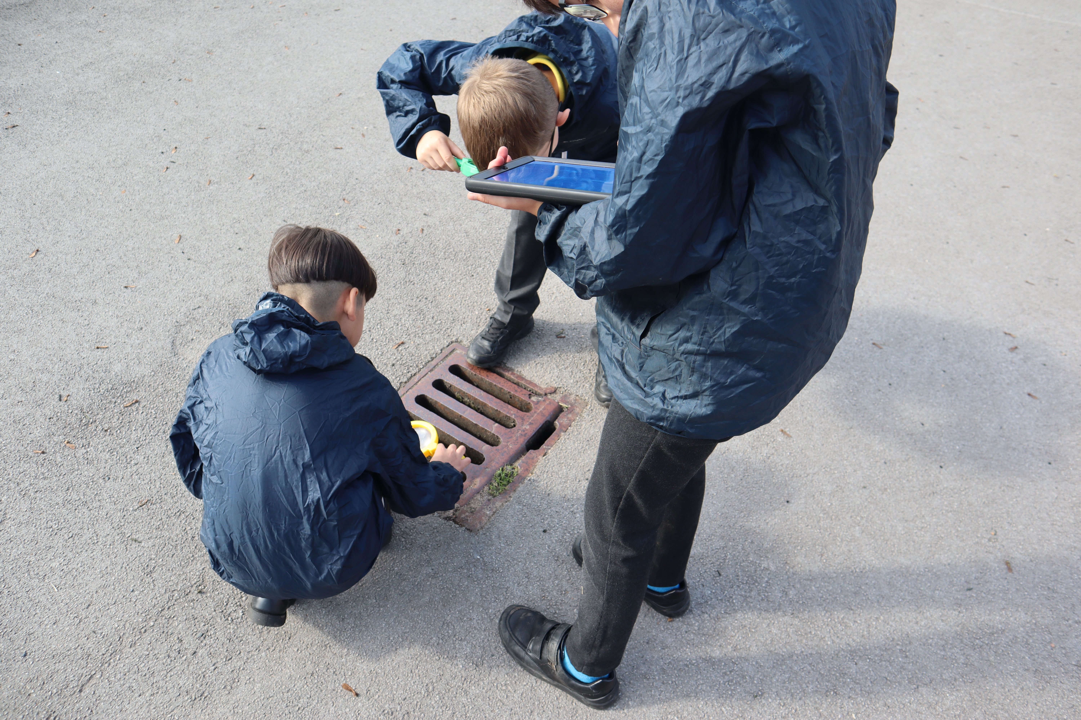
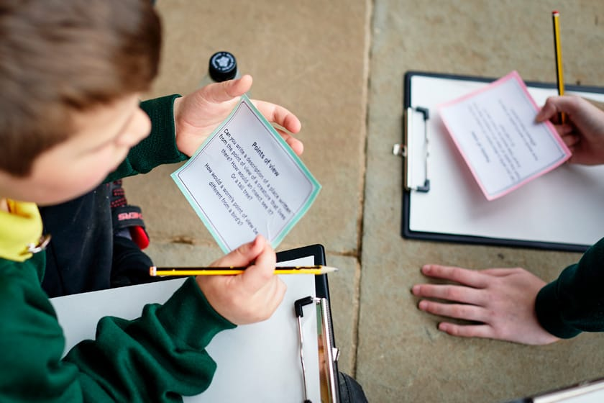
Quiz
What did Nature Park schools/colleges/nurseries do this year?
Install a pond
Discover hidden nature on their site
Imagined being a spider
A pond installed at a nursery in Birmingham
Pupils taking part in the Hidden Nature Challenge
A pupil taking part in the Points of View activity

Slide 8
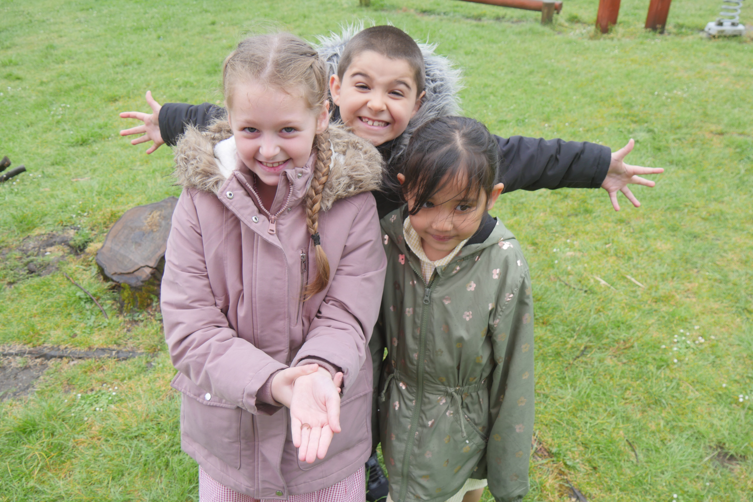
Quiz
What is Habitat Heroes?
An activity for children and young people to discover homes for wildlife
Being a superhero

Slide 9
Quiz
What is Habitat Heroes?
An activity for children and young people to discover homes for wildlife
Being a superhero
Habitat Heroes is one of our Nature Park activities that helps you find homes for wildlife in your school! Everyone who took part is also definitely a wildlife superhero. You can still take part here.

Slide 10
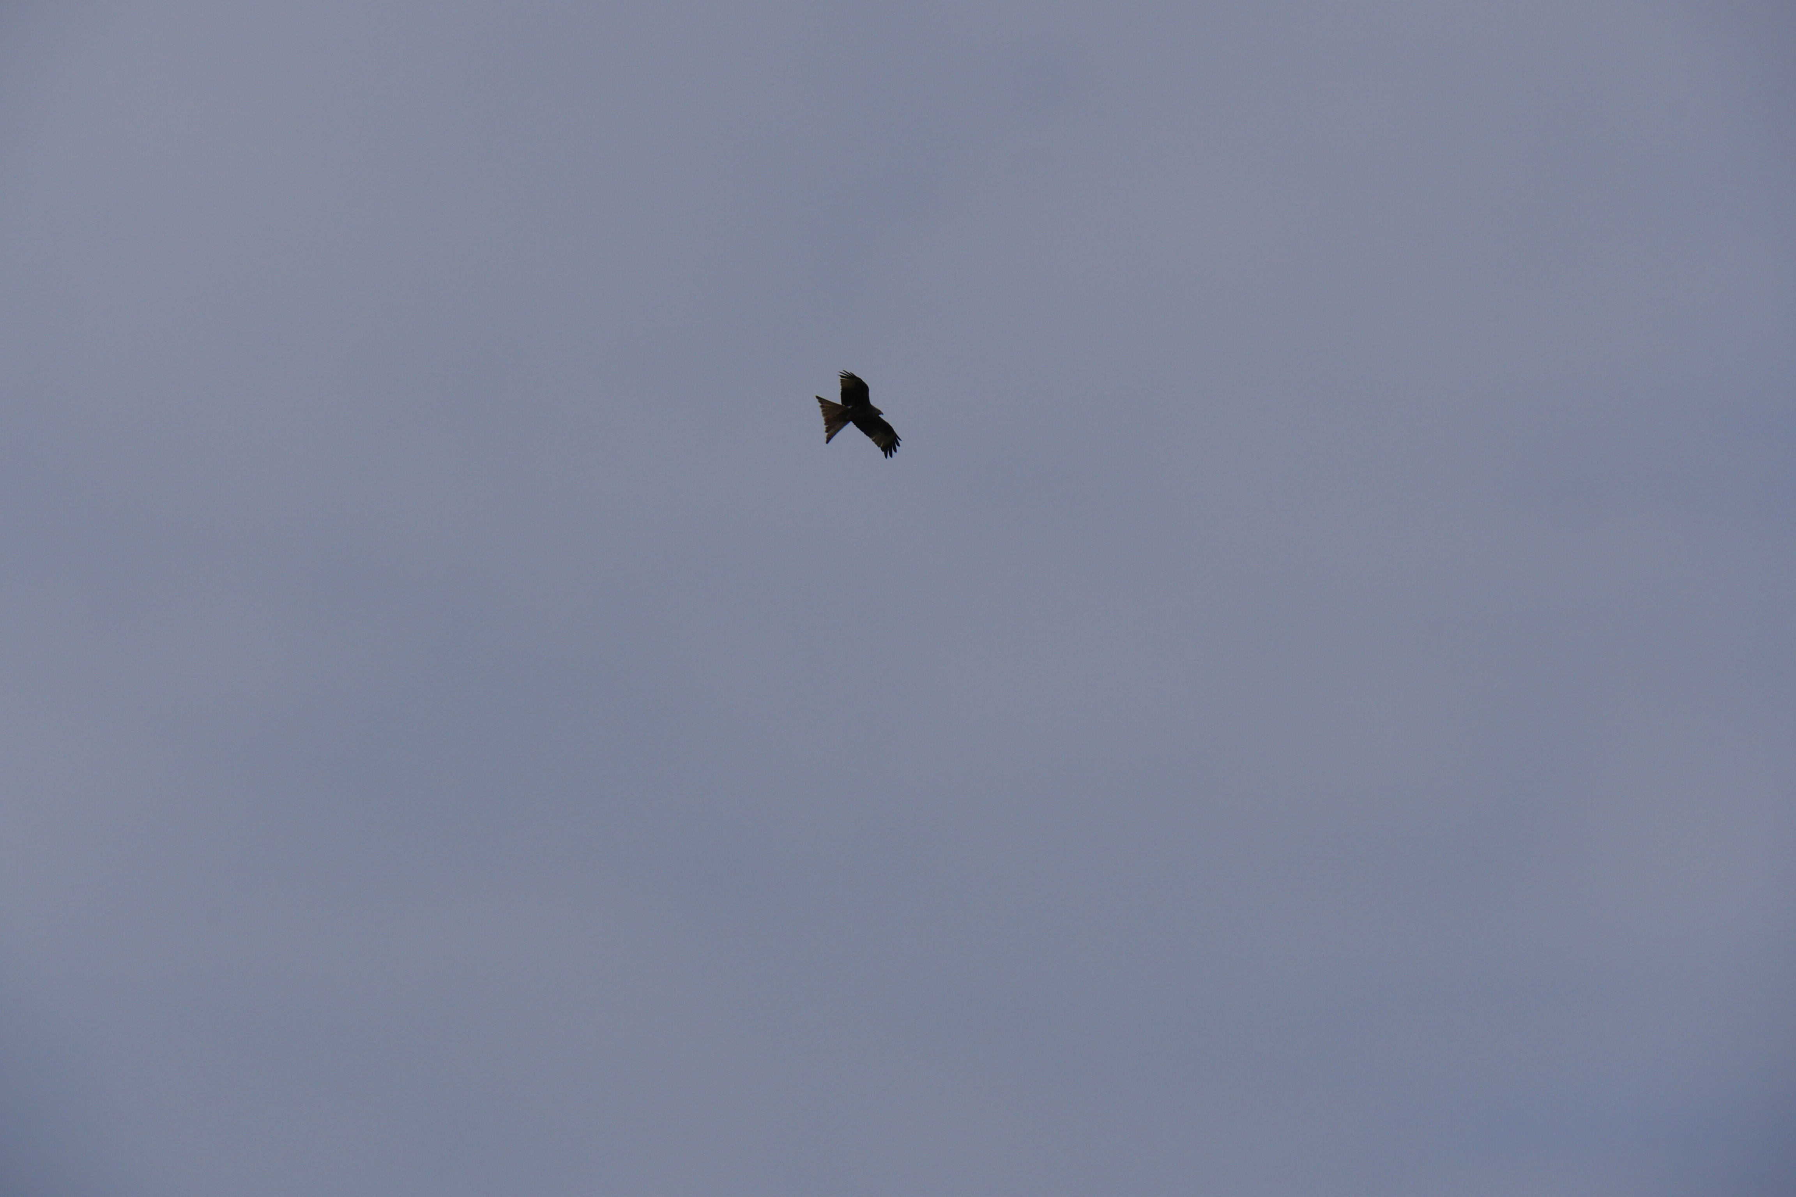
Quiz
Which of these have been found in school grounds this year?
Sparrowhawks
Peregrine falcons
Foxes

Slide 11
Quiz
Which of these have been found in school grounds this year?
Sparrowhawks
Peregrine falcons
Foxes
All of these were found in Nature Park settings this year! Sparrowhawks in Leeds, peregrine falcons in the Midlands and foxes in Yorkshire

Slide 12
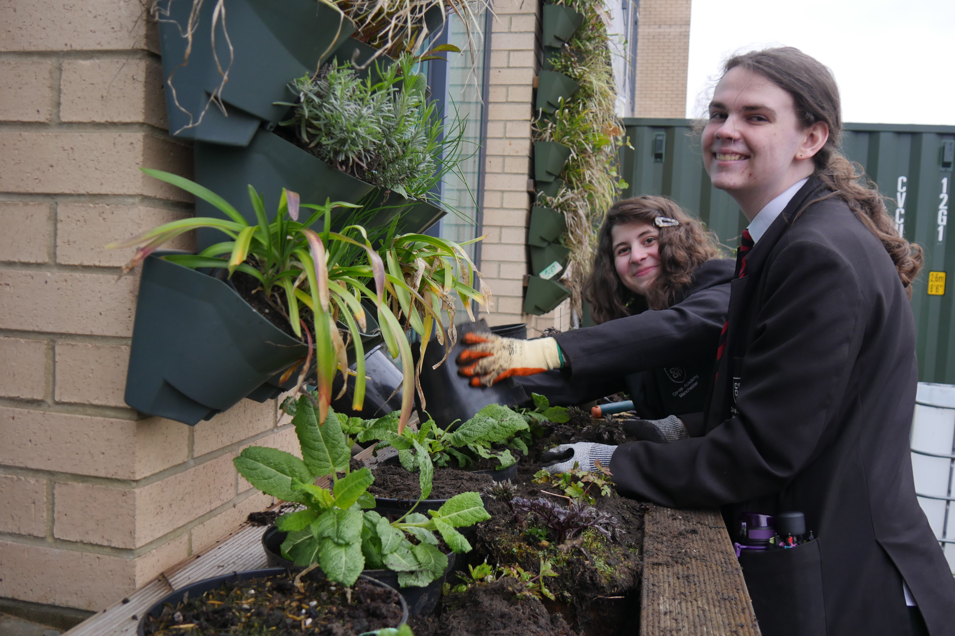
Quiz
What skills can you learn by taking part in the Nature Park?
Recognising different plants and animals are
How to look after the environment
How to tell other people about what you have done

Slide 13
Quiz
What skills can you learn by taking part in the Nature Park?
Recognising different plants and animals are
How to look after the environment
How to tell other people about what you have done
By taking part in the Nature Park you are learning a range of different green skills, that link to school subjects
You will learn how to record data, interpret and understand data, think creatively and make decisions

Slide 14
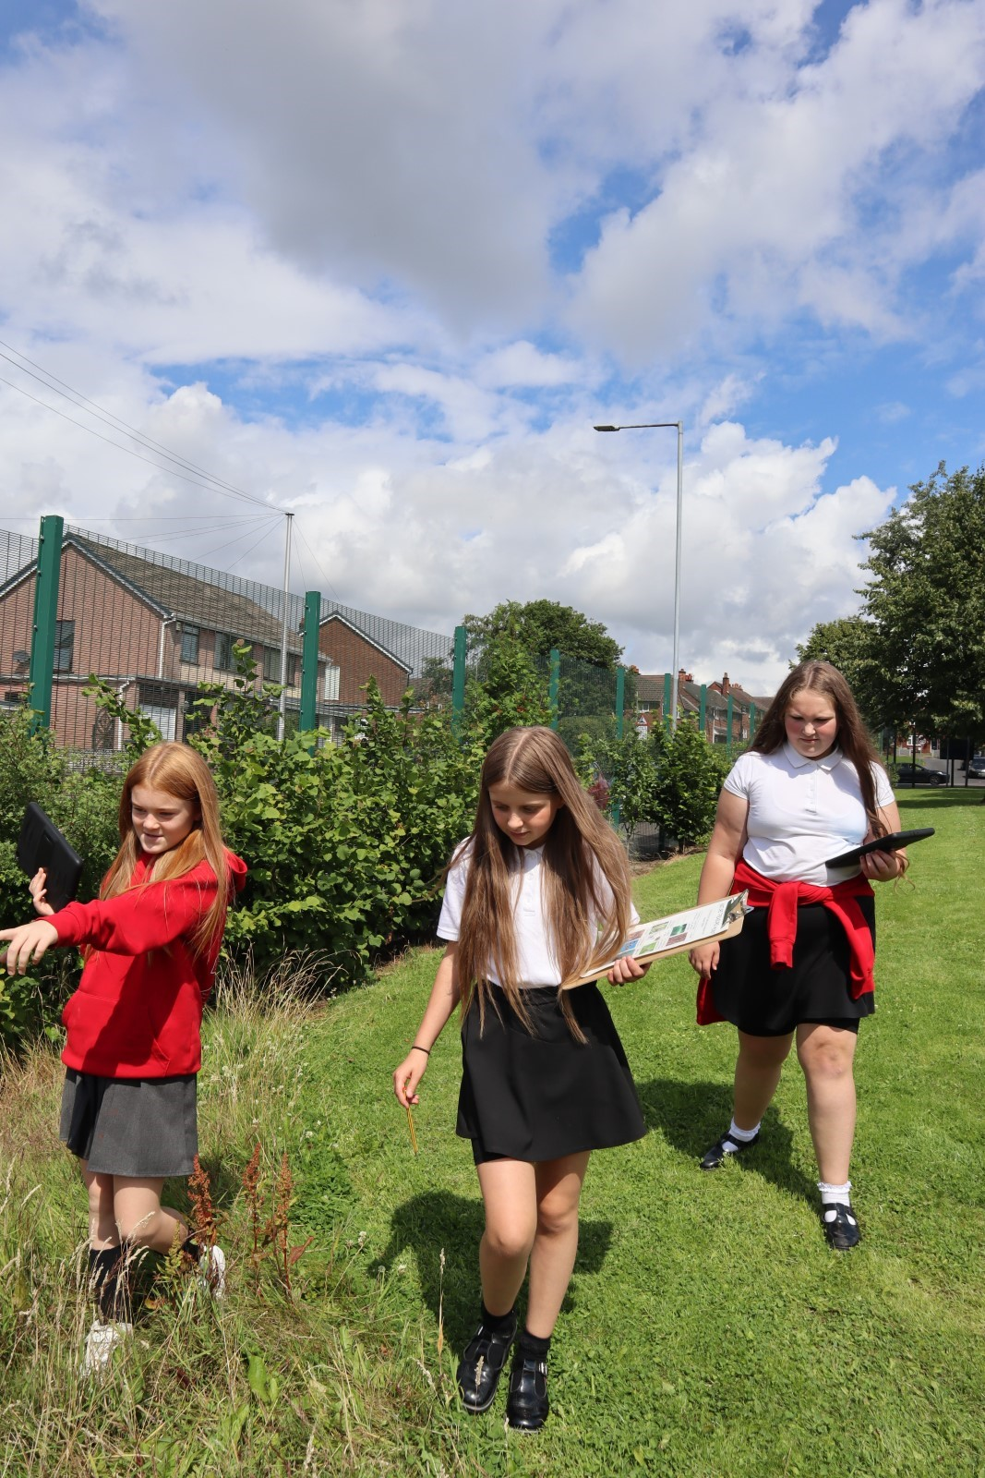
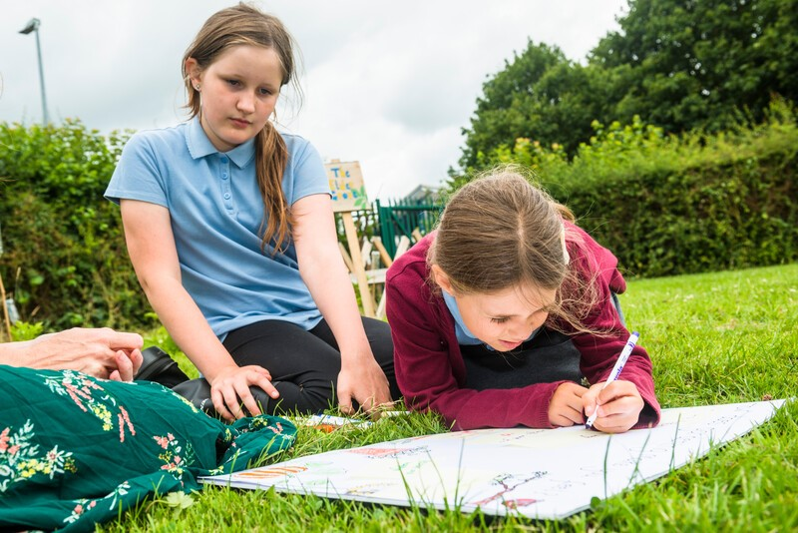
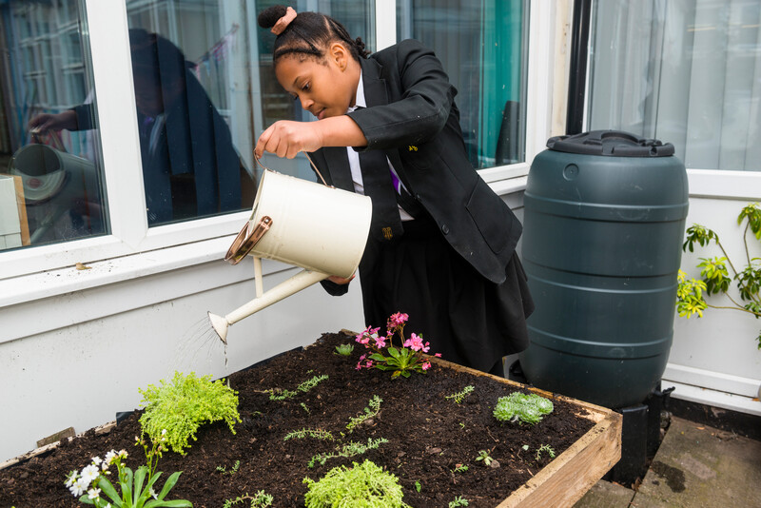
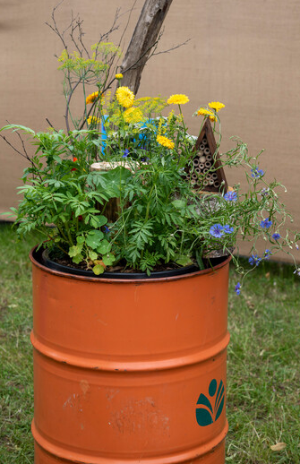
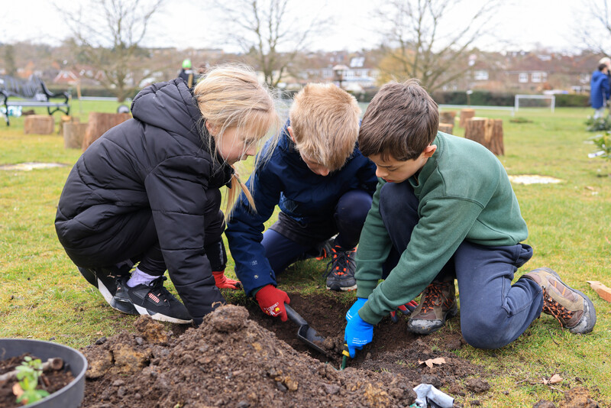
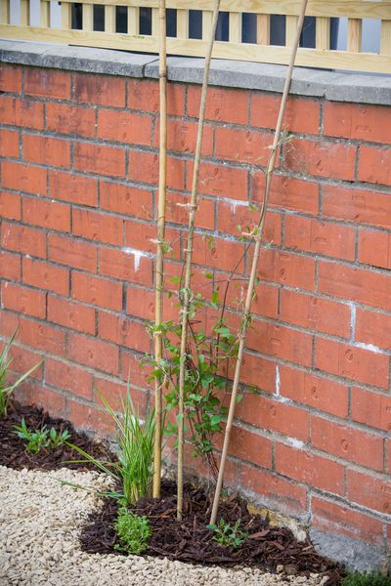
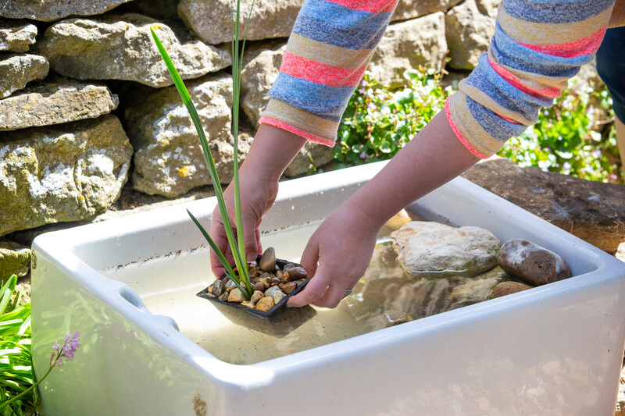
Our Nature Park
Notes:
Insert photos of any Nature Park activities or improvements for nature you have made this year
This could be presented by children or young people who were involved

Slide 15

Celebrating our achievement
Insert school name here
Notes:
A chance to give out certificates to individuals/classes/groups/the school to celebrate your participation in the Nature Park this year
If you have any special visitors at your assembly you could ask them to present the certificates to the children/young people

Slide 16
Zine for nature
Notes:
Share your zine for nature if you have completed this activity

Slide 17
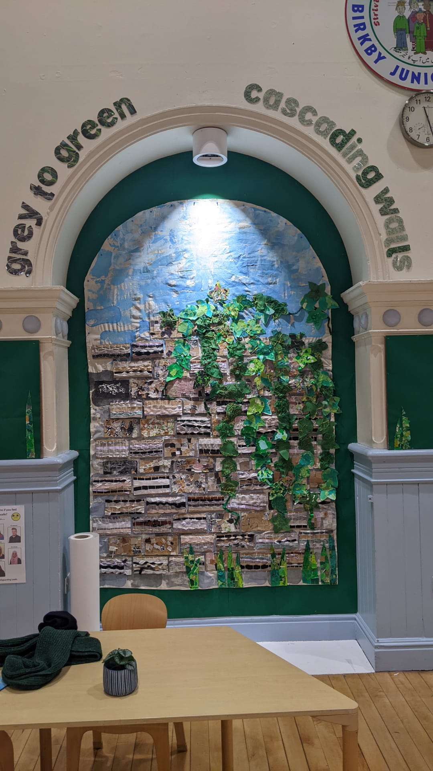
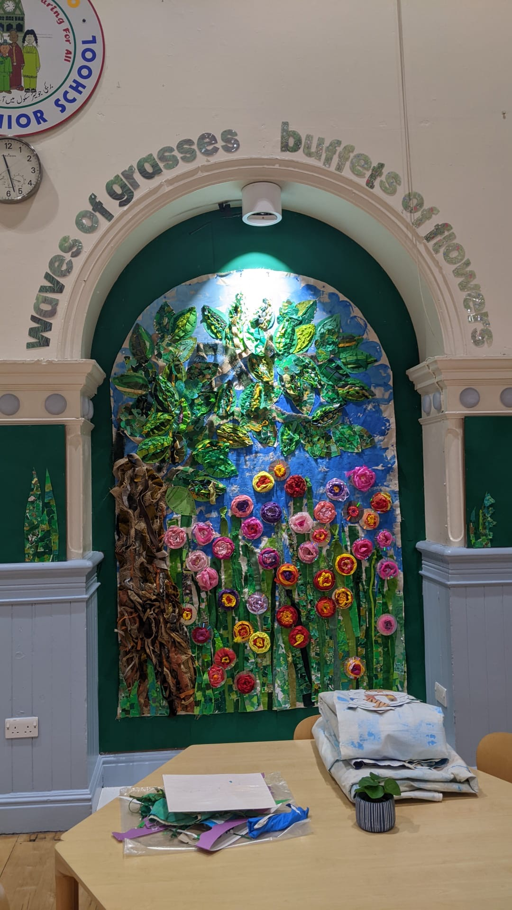
Vision statement
Notes:
Insert your vision statement and share with your school/college/nursery community

Slide 18
Get involved
Notes:
A call to action for staff/pupils to get involved with the Nature Park next year
Share any plans you have for next year with your Nature Park

